Slide 1
UBER SUPPLY DEMAND GAP
Contribution - Individual
Team Member - P.Jayagopi

Slide 2
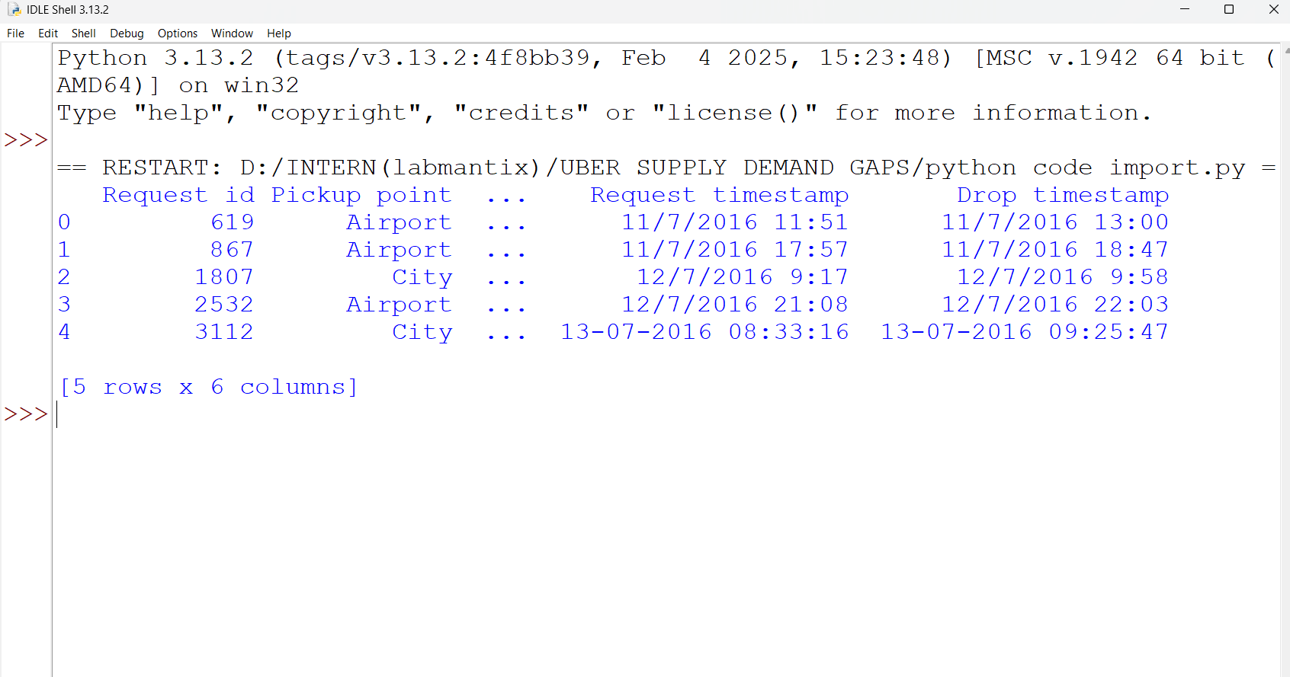
Importing the dataset and library

Slide 3
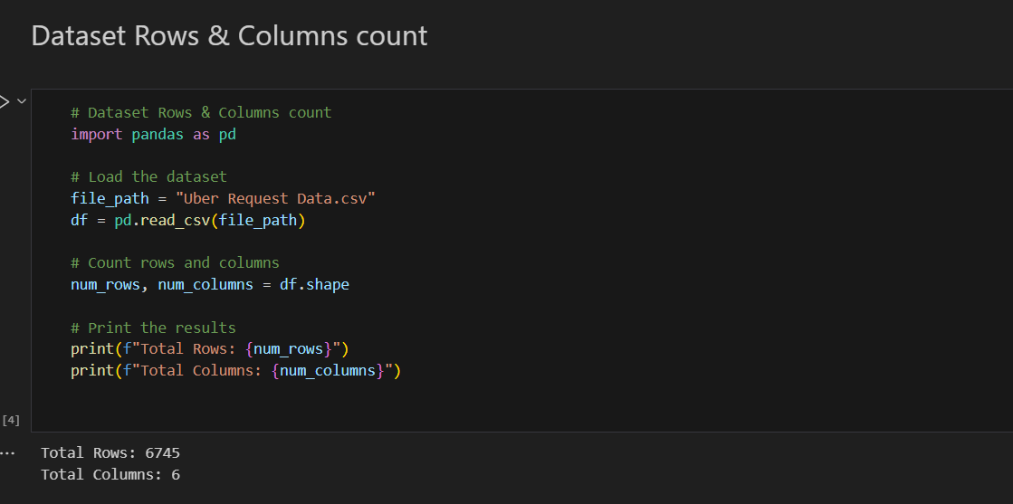
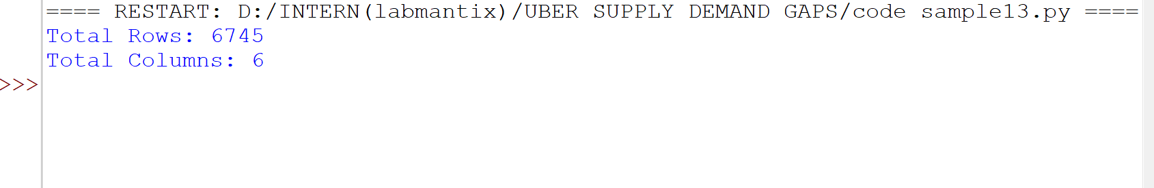
Display of frist few rows and column

Slide 4
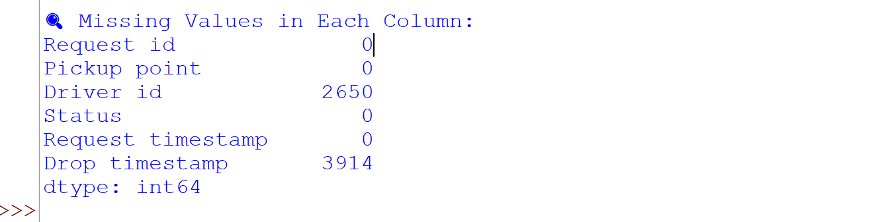
Missing and duplicate values

Slide 5
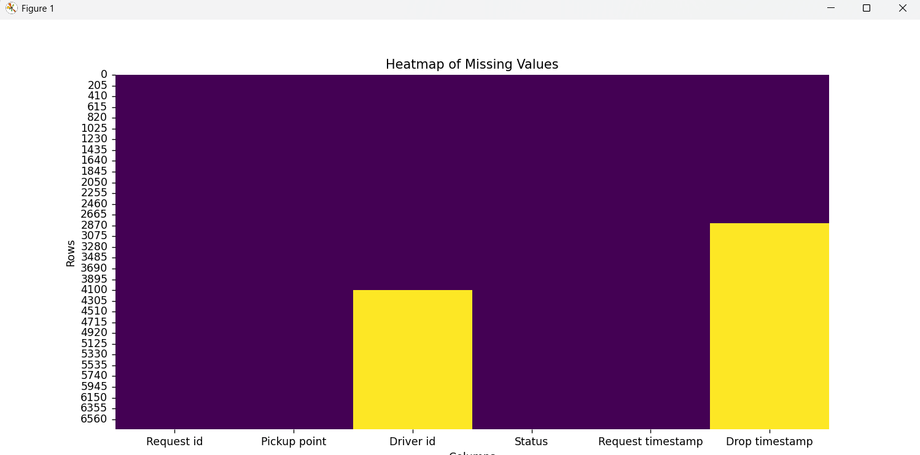
HeatMaps for Missing values

Slide 6
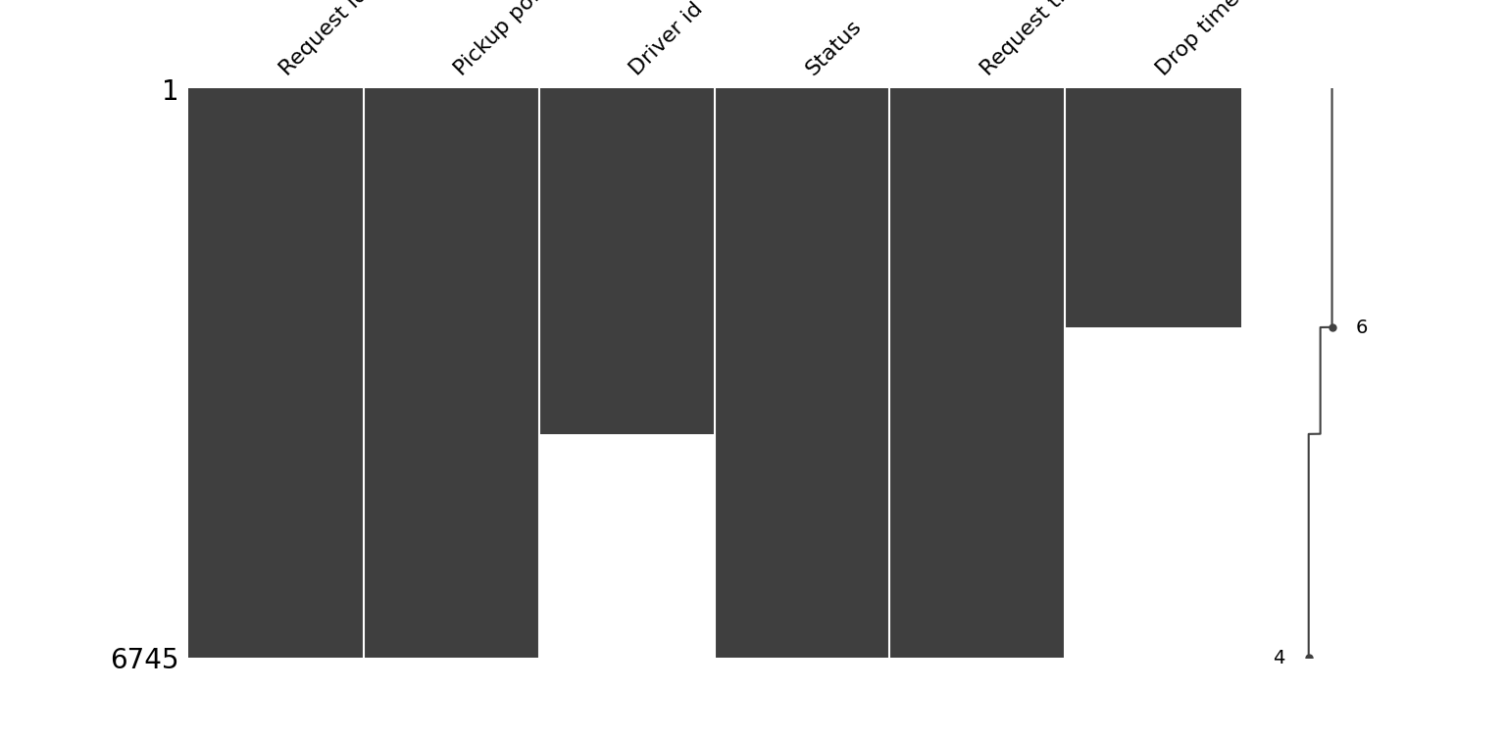
Types of charts and their outputs

Slide 7
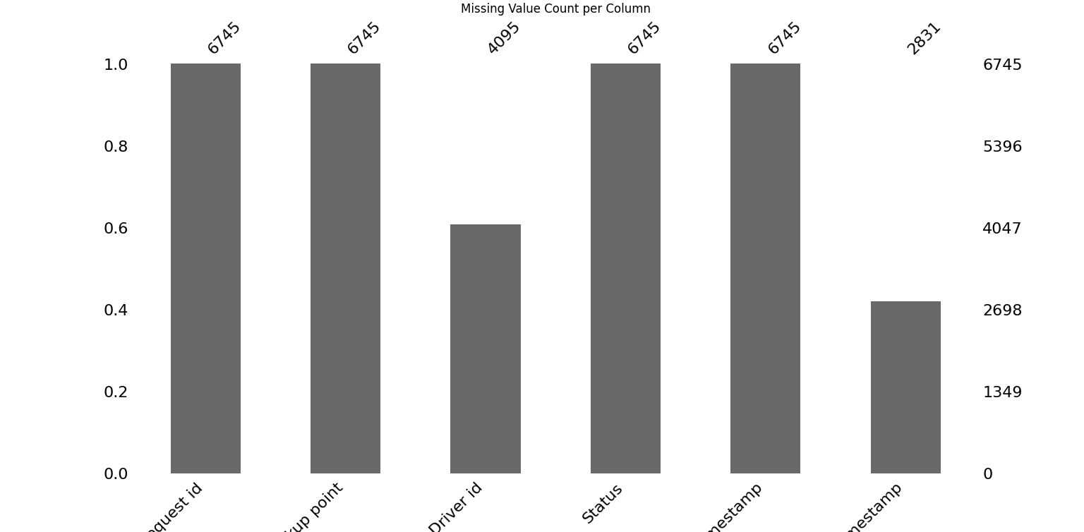
Bar chart for the Missing value

Slide 8
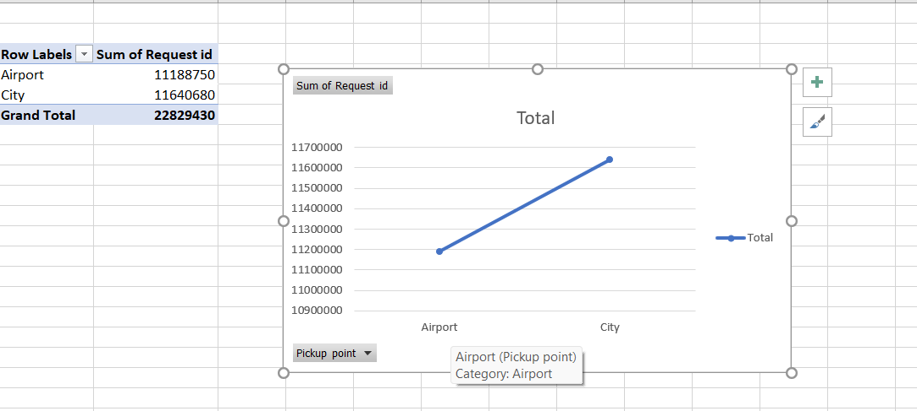
Line chart
This line denotes the Sum of Request id and the pickup location of the dataset from the given for the analyzing the data

Slide 9
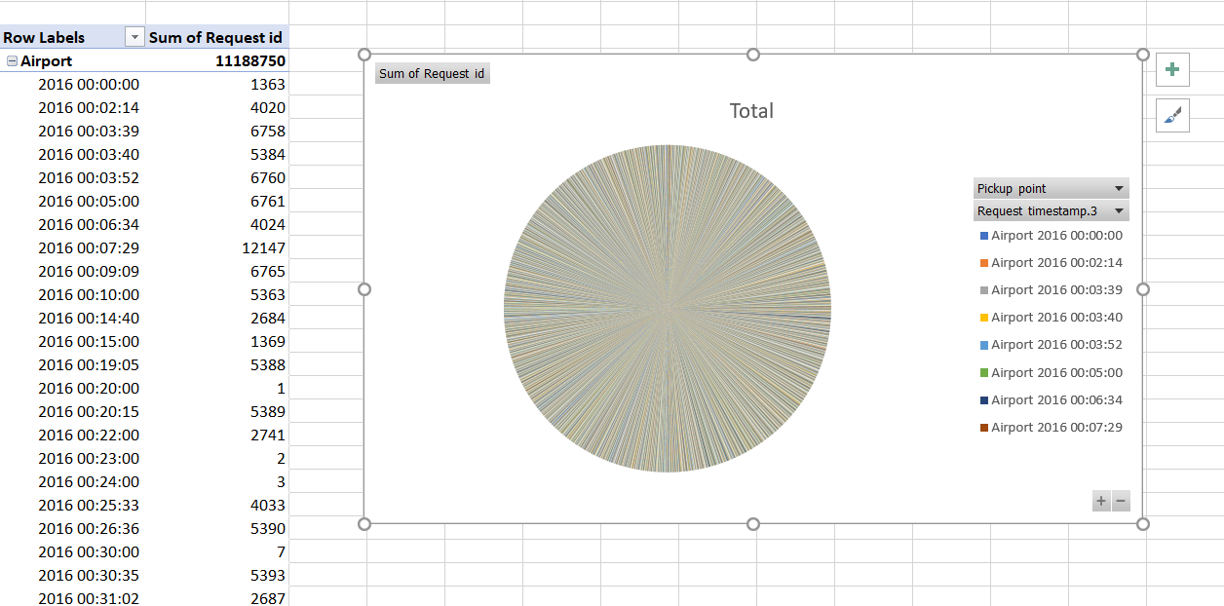
Pie Chart
This chart gives the overall description for the different parts of the dataset and the request timestamp

Slide 10
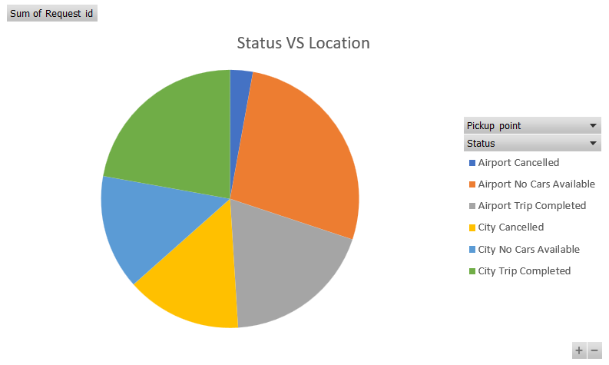

Slide 11
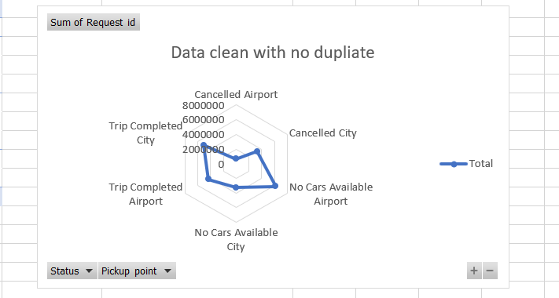
Radar map chart

Slide 12
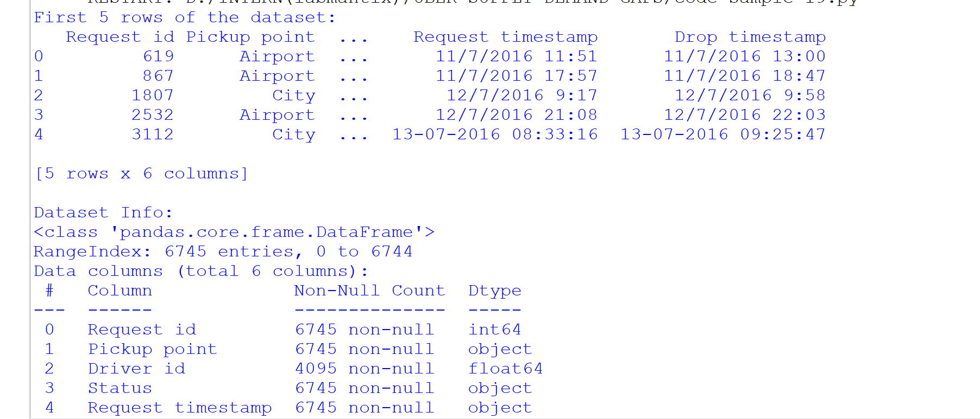
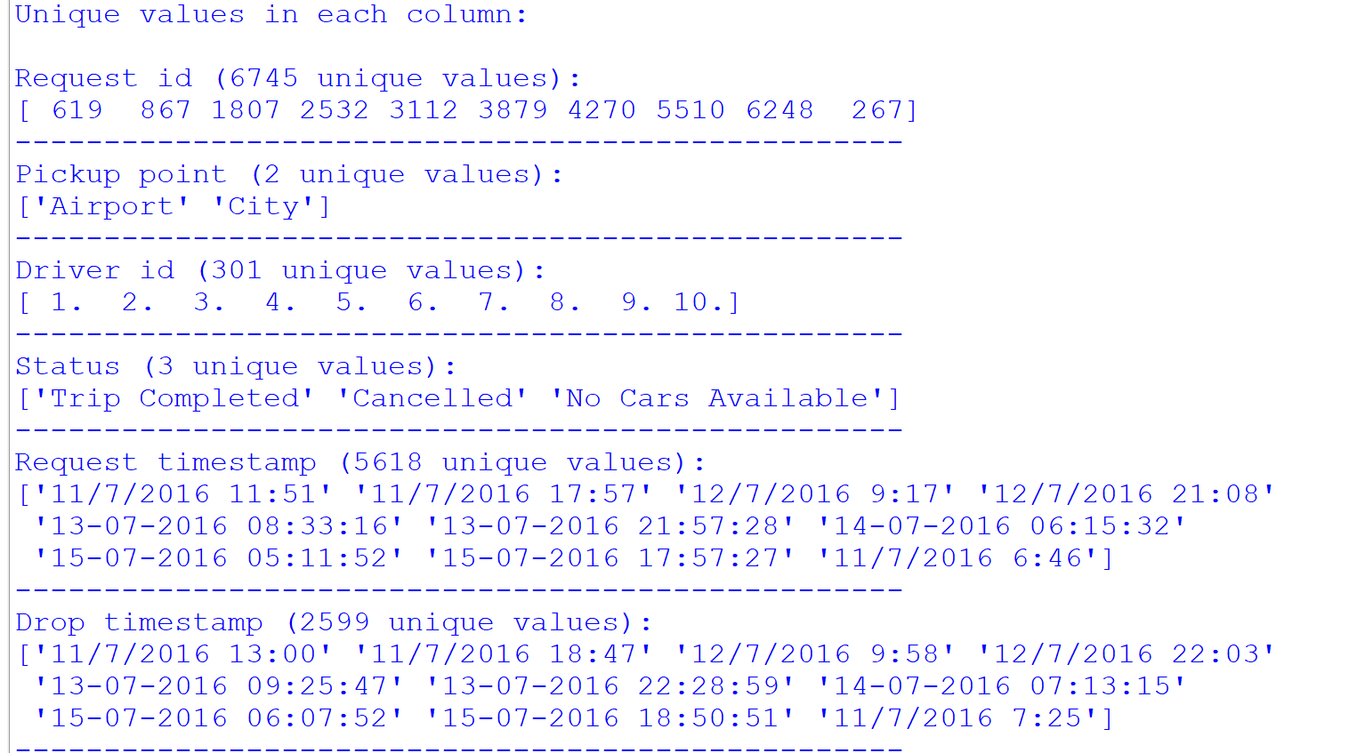
Exploratory Data Analysis Outputs

